Slide 1
Questions Asked & Answered
Stephanie M. Carter
AP Seminar Consultant
McCracken County High School
Paducah, KY
July 29, 2017

Slide 2
What does the data say? Understanding and Analyzing Context
According to the respective Instructional Planning Reports
In this Transferable Skill,
Students in 2017 Earned 22/30
in 2016 Earned 21/30
in 2015 Earned 21/30

Slide 3
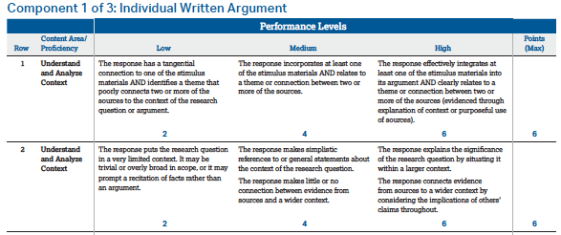
Understanding and
Analyzing Context
On the Rubrics

Slide 4
What does the Chief Reader say? As presented in the 2016 Student Performance Q&A section: “…what message would you like to send to teachers that might help them to improve the performance of their students on the exam?”
Synthesis Essay – Practice developing arguable claims and complicated questions without trite answers.
Individual Research Report – Give students adequate time to refine the controlling team question, one that is debatable, researchable, and invites multiple perspectives.
Individual Written Argument – Help students to develop and revise research questions that are authentically connected to the source material.
Help students develop and revise strong, focused, complex questions that invite debate, as broad questions lead to overly general papers that are more expository than argumentative.
Make the research question the title of the paper or have students explicitly state the question in the introduction. Guessing leads to misunderstanding.

Slide 5
What does the Chief Reader say? As presented in the 2015 Student Performance Q&A section: “…what message would you like to send to teachers that might help them to improve the performance of their students on the exam?”
Synthesis Essay – Teach students to explore the complexities and ambiguities in a chosen focus area.
Individual Research Report – Give students adequate time to refine the controlling team question, one that is debatable, researchable, and invites multiple perspectives. Teach students that initial research informs the selected question, and the selected question informs subsequent research.
Individual Written Argument – Encourage students to be explicit in what their paper will explore; offer a clear, well-scoped research question.
Help students devise a research question that invites an argument with multiple perspectives and is of appropriate scope.
Make sure the response answers the research question while exploring a diversity of perspectives and possible objections and limitations.

Slide 6
What can teachers do? Use these strategies on Released Student Samples and as Students Compose.
Topic + Question + Significance
Criteria for Research Questions
Examining Your Question
Reverse Outlining
The Scoring Approaches
The Rubrics
Notes:
Read 2.5 pages of IWA Sample 1 (3-5 of 35), 1 paragraph of Sample 2 (page 14 of 35), 1 page of IWA Sample 3 (23/35)
Intervene before 2,000 words are written.

Slide 7
TQS: Topic + Question + Significance.
According to Booth, in “From a Question to its Significance,” the process looks like this:
Step 1: Name Your Topic
If you are beginning a project with only a topic and maybe the glimmerings of a good question or two, start by naming your project: I am trying to learn about (working on, studying) ____________.
Fill in the blank with your topic:
I am studying the causes of the disappearance of large North American mammals.
I am working on Lincoln’s beliefs about predestination and their influence on his reasoning.
I am working on stories about the Battle of the Alamo.
Booth’s Craft of Research and Turabian’s Student’s Guide to Writing College Papers suggest
TQS:
Topic + Question + Significance.

Slide 8
TQS: Topic + Question + Significance.
According to Booth, in “From a Question to its Significance,” the process looks like this:
Step 2: Add an Indirect Question
Add an indirect question that indicates what you do not know or understand about your topic:
I am studying / working on ____________ because I want to find out who / what / when / where / whether / why / how ____________.
When you add that because I want to find out how / why / whether clause, you state why you are pursuing your topic: to answer a question important to you.
I am studying the causes of the disappearance of large North American mammals because I want to find out whether they were hunted to extinction.
I am working on Lincoln’s beliefs about predestination and its influence on his reasoning because I want to find out how his belief in destiny influenced his understanding of the causes of the Civil War.
I am working on stories about the Battle of the Alamo because I want to find out why its story became a national legend.
Booth’s Craft of Research and Turabian’s Student’s Guide to Writing College Papers suggest
TQS:
Topic + Question + Significance.

Slide 9
TQS: Topic + Question + Significance.
According to Booth, in “From a Question to its Significance,” the process looks like this:
Step 3: Answer “So What?”
… you have moved beyond the aimless collection of data. But now, if [when] you can, take one step more. It’s one that advanced researchers know they must take, because they know their work will be judged not by its significance to them but by its significance to others in their field. They must have an answer to So what?
Add a second indirect question that explains why you asked your first question. Introduce this second implied question with in order to help a specific audience understand how, why, or whether:
I am studying / working on ____________ because I want to find out who / what / when / where / whether / why / how ____________ in order to help _____________ understand _____________.
I am studying the causes of the disappearance of large North American mammals because I want to find out whether the earliest peoples hunted them to extinction in order to help my reader understand whether native peoples lived in harmony with nature or helped destroy it.
Booth’s Craft of Research and Turabian’s Student’s Guide to Writing College Papers suggest
TQS:
Topic + Question + Significance.

Slide 10
TQS: Topic + Question + Significance.
I am working on Lincoln’s beliefs about predestination and their influence on his reasoning because I want to find out how his belief in destiny and God’s will influenced his understanding of the causes of the Civil War, in order to help my peers understand how his religious beliefs may have influenced his military decisions.
I am working on stories about the Battle of the Alamo because I want to find out why its story became a national legend so I can help my classmates understand how such regional myths have shaped America’s sense of a national identity.
… Make no mistake, beginning your research without a good answer to that third question --- Why does this matter? --- is problematic because answering that last question is your ticket into the conversation of your community of researchers.
Booth’s Craft of Research and Turabian’s Student’s Guide to Writing College Papers suggest
TQS:
Topic + Question + Significance.

Slide 11
Criteria for Research Questions Prepare students to look for these qualities and use Gallery Walks to provide peer feedback on questions.
Require a judgement or evaluation to be made, not just description or exposition.
Are researchable. (It is possible to find relevant and credible sources.)
Involve genuine points of ongoing debate.
Invite engagement with alternative perspectives.
Are simple and do not contain multiple, nested questions.

Slide 12
Examining Your Question Ask students to use Google Slides or a similar collaborative presentation tool to share the thinking behind their research questions and allow peers to provide feedback.
Your Question
Begin with Your Question but don’t think of it as static. The question should evolve as your research progresses. In fact, it will likely change as you gather enough information to complete this task.
Context & Significance
What is the context of your question? Why is it a question worth exploring? What importance does it have and to whom or what?
General Points of Ongoing Debate
If this is a question worth exploring, other voices are offering Genuine Points of Ongoing Debate. Remember that those voices don’t have to contradict each other; they should make claims and offer evidence in support of those claims. What are some of those claims and how do they relate to each other? How will they help you answer Your Question?

Slide 13
Examining Your Question
Plan/Organization
Like Your Question, your Plan – Organization might change but the sooner you have a Plan to answer Your Question, the more likely you are to do so. Your Organization should make your line of reasoning clear. How should the parts fit to come to a logical conclusion or judgment?
Anticipated Judgement
The conclusion or judgment to which you finally come may or may not be the same as this original Anticipated Judgment but you need to hear yourself answer Your Question. Is any research actually required to Anticipate a Judgment? If not, you’ve got the wrong question. This Anticipated Judgment will be tested and you should return to it often as you research to see how your original thinking has been impacted by your research.
Multiple Lenses or Perspectives
Whether you consider your question through Multiple Lenses or Perspectives, you must find different ways to analyze, or break down, your question. The voices of the Ongoing Debate might be a starting point but you must differentiate between them and specify the Lenses or Perspectives through which you will work to answer Your Question.
Notes:
http://shoutkey.com --- show how easy it is to access even without Google Slides.

Slide 14
Reverse Outlining
Amherst College’s Method Includes:
Reading the essay and writing the main idea of each paragraph.
Comparing your thesis to each main idea.
Check for signposts/transitions.
Revise for Organization and purposeful Use.
Modifications Include:
Also writing an explanation of the purpose of each paragraph.
Also writing the minor claims and supporting evidence.
Removing all information from or related to sources and reading the student’s words.
Notes:
https://www.amherst.edu/academiclife/support/writingcenter/resourcesforwriters/revision/reverse_outline

Slide 15
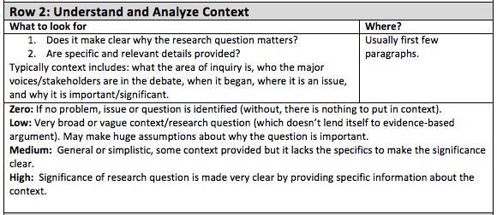
Scoring Approaches
Individual Written Argument
As soon as the Scoring Training is released, avail yourself of the Professional Development:
PT 1: Individual Research Report and Team Multimedia Presentation
and
PT 2: Individual Written Argument.
And share the Scoring Approaches with your Students.

Slide 16
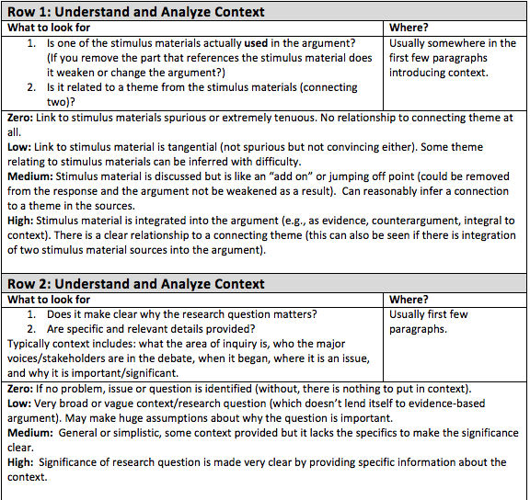
Scoring Approaches
Individual Multimedia Presentation
As soon as the Scoring Training is released, avail yourself of the Professional Development:
PT 1: Individual Research Report
and
PT 2: Individual Written Argument and Individual Multimedia Presentation.
And share the Scoring Approaches with your Students to score Released Student Samples and Student Drafts.

Slide 17
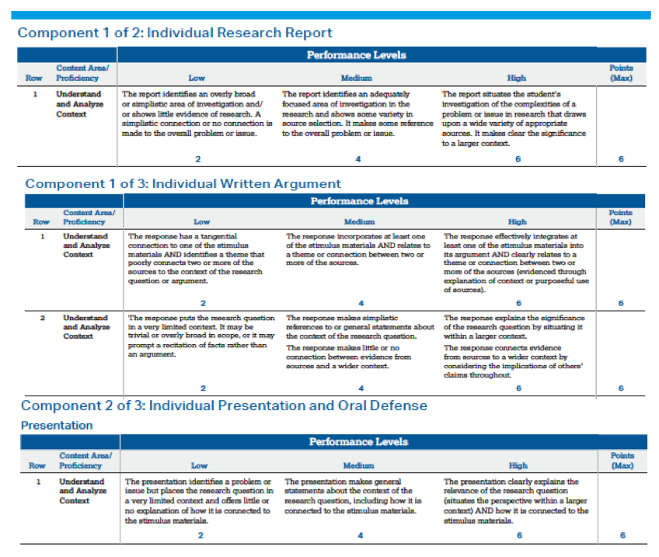
The Rubrics
As early and as often as possible, introduce the Rubrics to your students.
Use the Rubrics to score Released Student Samples and Student Drafts.
Apply the Rubrics to published and unpublished texts.

Slide 18
What Strategies can you share?

Slide 19
Thank You & Good Luck!

